Slide 1


Deep Learning for Natural Language Processing DLNLP 2: The Perceptron
Mihai Surdeanu and Marco A. Valenzuela-Escárcega

Slide 2
Take away
Text classification
The perceptron decision function
The perceptron learning algorithm
Visualizing the perceptron learning
Voting perceptron
Average perceptron
Evaluation measures for text classification
Drawbacks of the perceptron

Slide 3
Machine learning is easy

Slide 4

Let’s read a book

Slide 5


Slide 6


Slide 7


Slide 8


Slide 9
…

Slide 10


Slide 11
What have we learned from this book?
Objects are described by their properties or features
E.g.: isBig, hasTail, hasColor, numberOfLimbs…
Features have values
Boolean: true/false
Discrete: brown, white, etc.
Numerical: 4 for numberOfLimbs

Slide 12
What have we learned from this book?
Objects are assigned a discrete label, e.g., isMyMom, isNotMyMom
A learning algorithm (the butterfly in the story) or classifier will learn how to assign labels to new objects
Hint: features are important if they lead to the correct decision; less important otherwise
Learning algorithms produce incorrect classifications when not exposed to sufficient data. This situation is called overfitting.

Slide 13
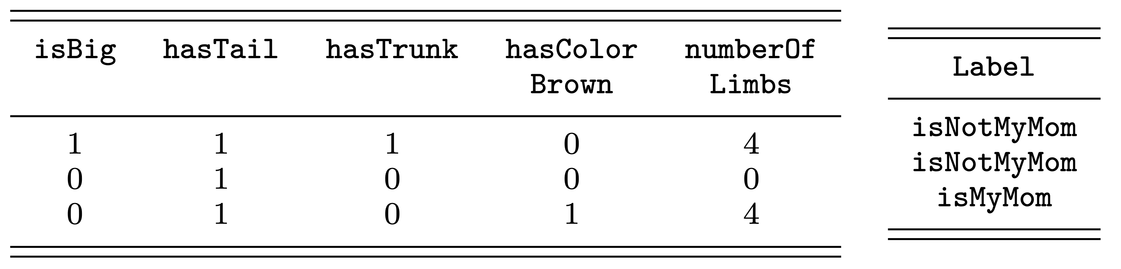
Let’s formalize what we know so far
Feature matrix X
One example per row
One feature per column
Label vector y
Supervised classification!

Slide 14
Use case: text classification
Text classification = learning algorithms that assign labels to text
Exercise: what applications of text classification do you know?

Slide 15
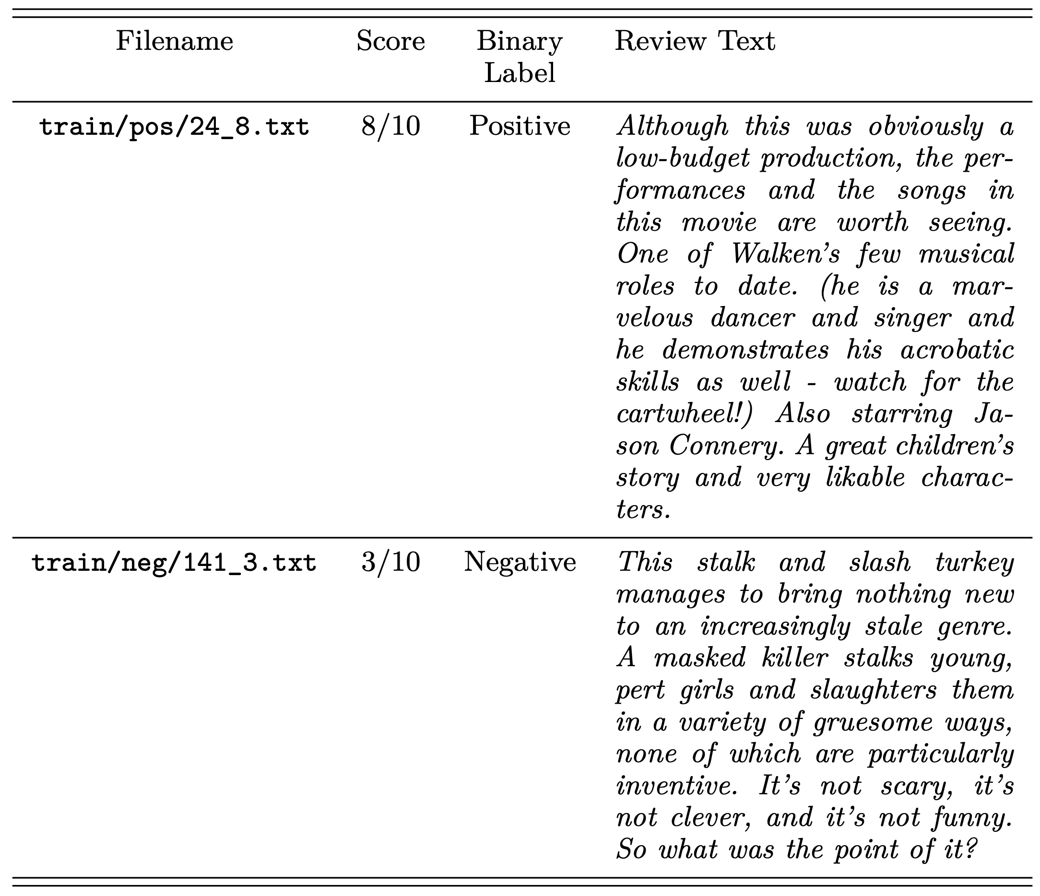
IMDB movie reviews dataset

Slide 16
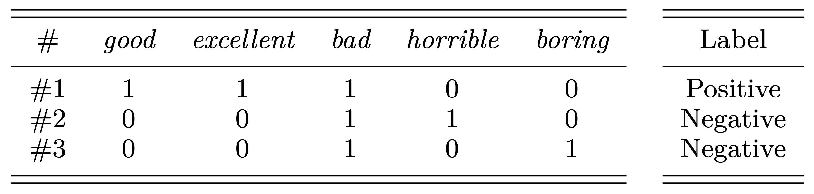
More formally…
Feature matrix X
Individual feature: how many times a given word appears in a review
Label vector y
Exercise: how many columns does X have?

Slide 17
The Perceptron

Slide 18
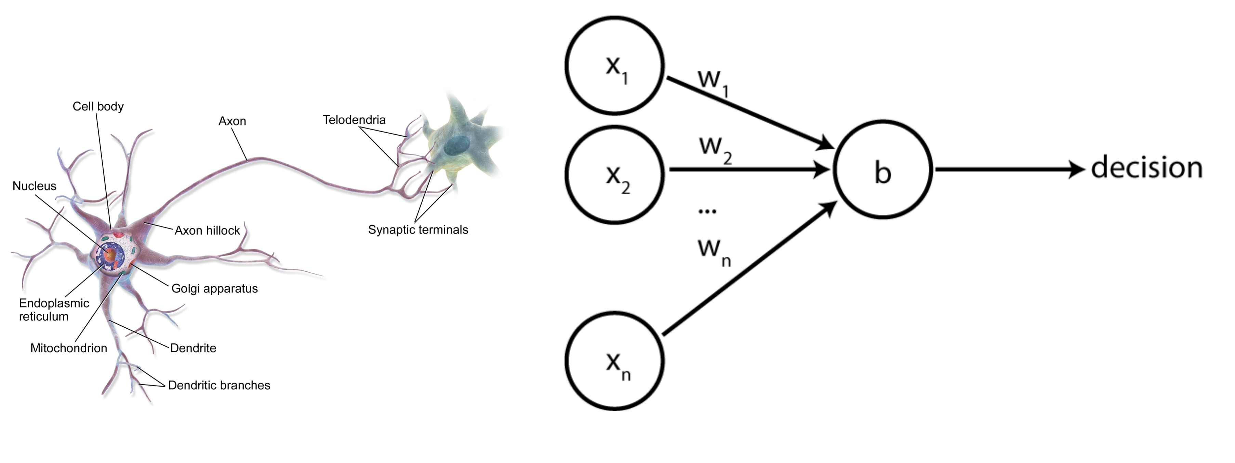
The perceptron

Slide 19
The perceptron

Slide 20
The perceptron
One row from the feature matrix X
These values are static, i.e., they do not change for a given example.

Slide 21
The perceptron
Weights that indicate how important each feature is
This is what is learned!

Slide 22
The perceptron
A scalar value called a bias term. This value is also learned.
We will explain why we (sometimes) need a bias term later.

Slide 23
The perceptron
A scalar value that is the classifier’s output. If >= 0 we assign one label; otherwise we assign the other label

Slide 24
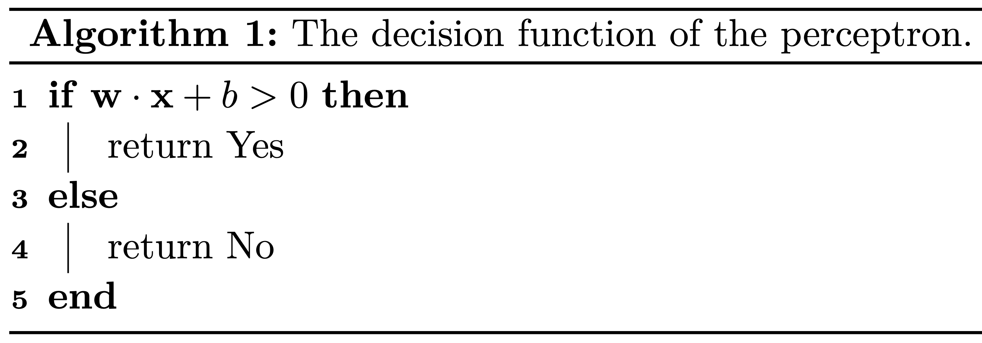
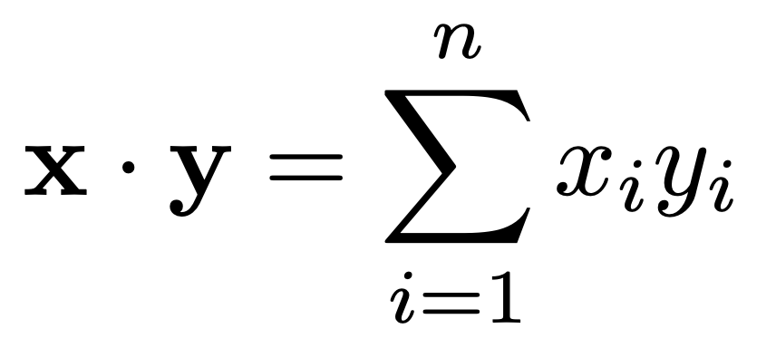
Perceptron decision function
Dot product of two vectors

Slide 25
Exercise
What is the dot product of these two vectors:
x = (1, 2, 3)
y = (2, 2, -3)

Slide 26
Intuition
If the Yes class is isMyMom then
We want the weight associated with hasColorBrown to be positive, and
The weight for hasTrunk to be negative
Similarly, for review classification (Yes == Positive) we want positive words to have positive weights, and negative words to have negative weights

Slide 27
How do we learn the perceptron weights to achieve this?

Slide 28
Exercise
What weights would you assign in w for this data?

Slide 29
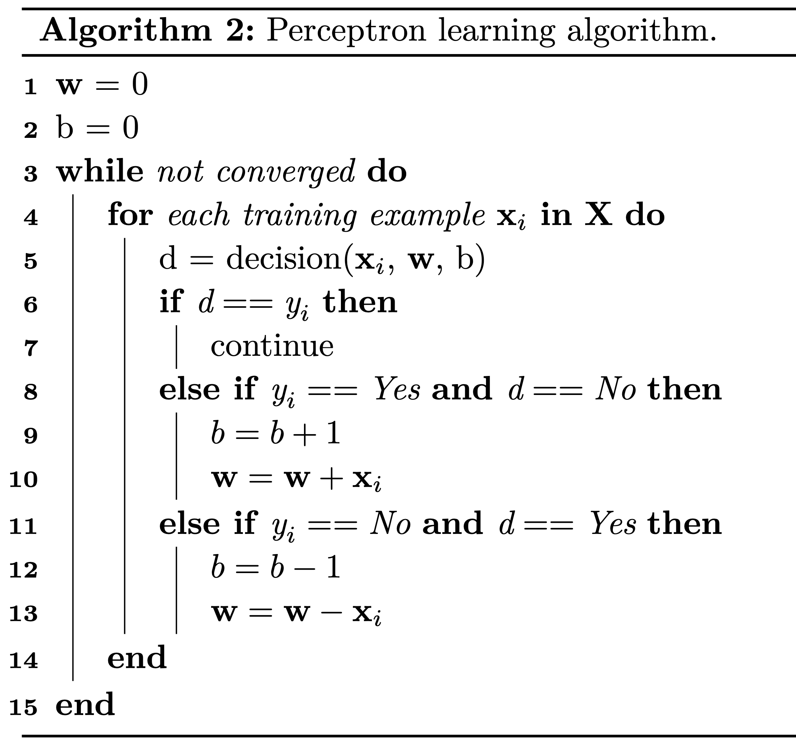
Training the perceptron

Slide 30
Training the perceptron
Initialize weights and bias with 0s

Slide 31
Training the perceptron
Cycle through the training data until the weights no longer change

Slide 32
Training the perceptron
Predict label using the current weights

Slide 33
Training the perceptron
The label is correct. Move on

Slide 34
Training the perceptron
We made a mistake on the positive (Yes) label
Add x_{i} to the weights

Slide 35
Training the perceptron
We made a mistake on the negative (No) label
Subtract x_{i} from the weights

Slide 36
Exercise
What are the perceptron’s weights after one pass over this training data?
Initially:
w = (0, 0, 0, 0, 0)
b = 0

Slide 37
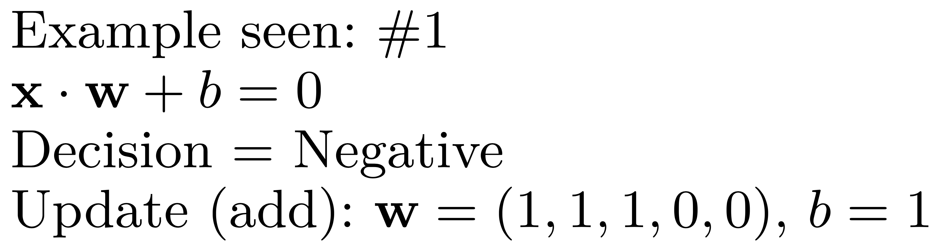
Exercise

Slide 38
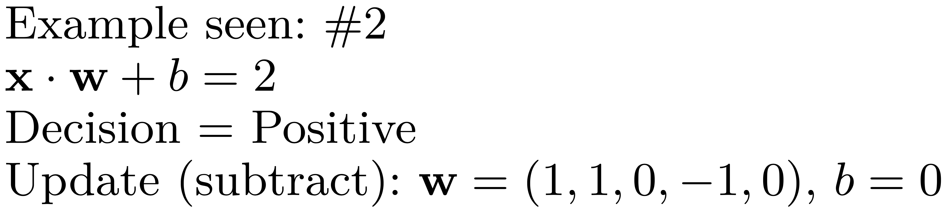
Exercise

Slide 39
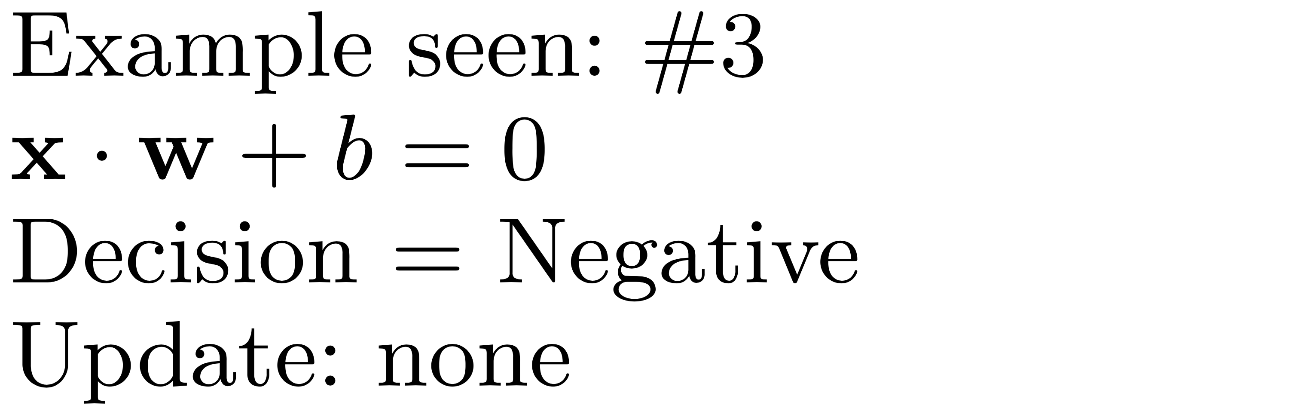
Exercise

Slide 40
Explainability
Now that we have a trained model, how would you manually inspect it to understand what was learned?

Slide 41
But why do we need that bias term?
In some cases the perceptron cannot learn without a bias term.
Let’s see an example

Slide 42
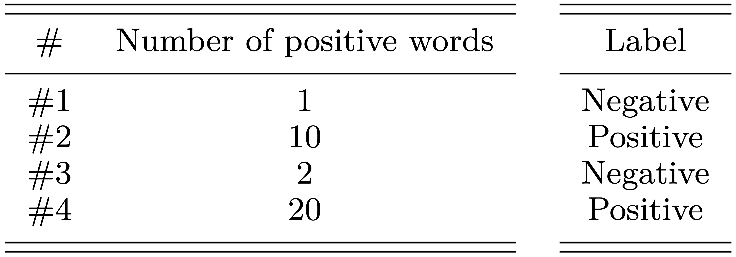
But why do we need that bias term?
After 4 passes (epochs) over this training data, the learned parameters are:
w = (2)
b = -4
Decision: 2x – 4 > 0
That is, a review must have at least three positive words to receive a positive label

Slide 43
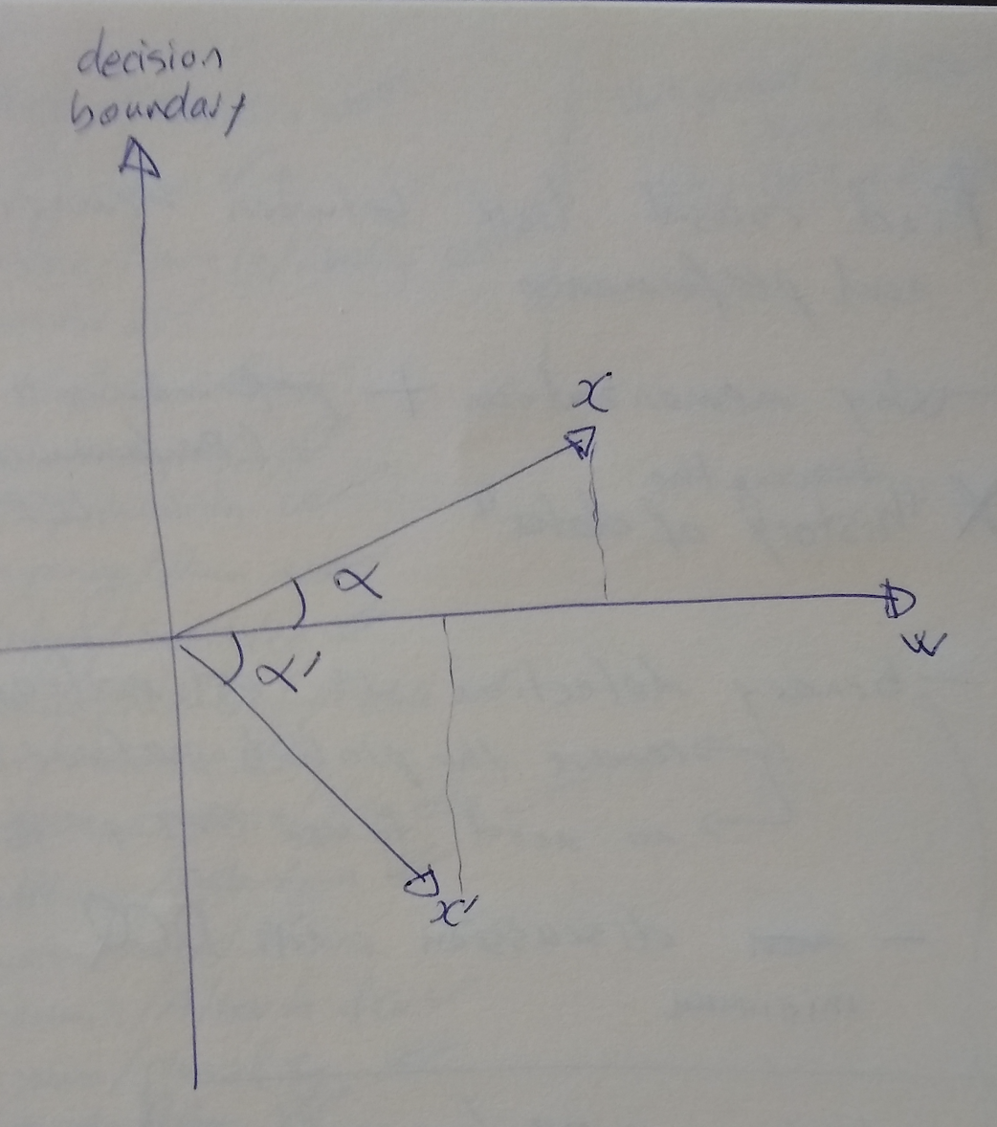
Visualizing the decision boundary

Slide 44
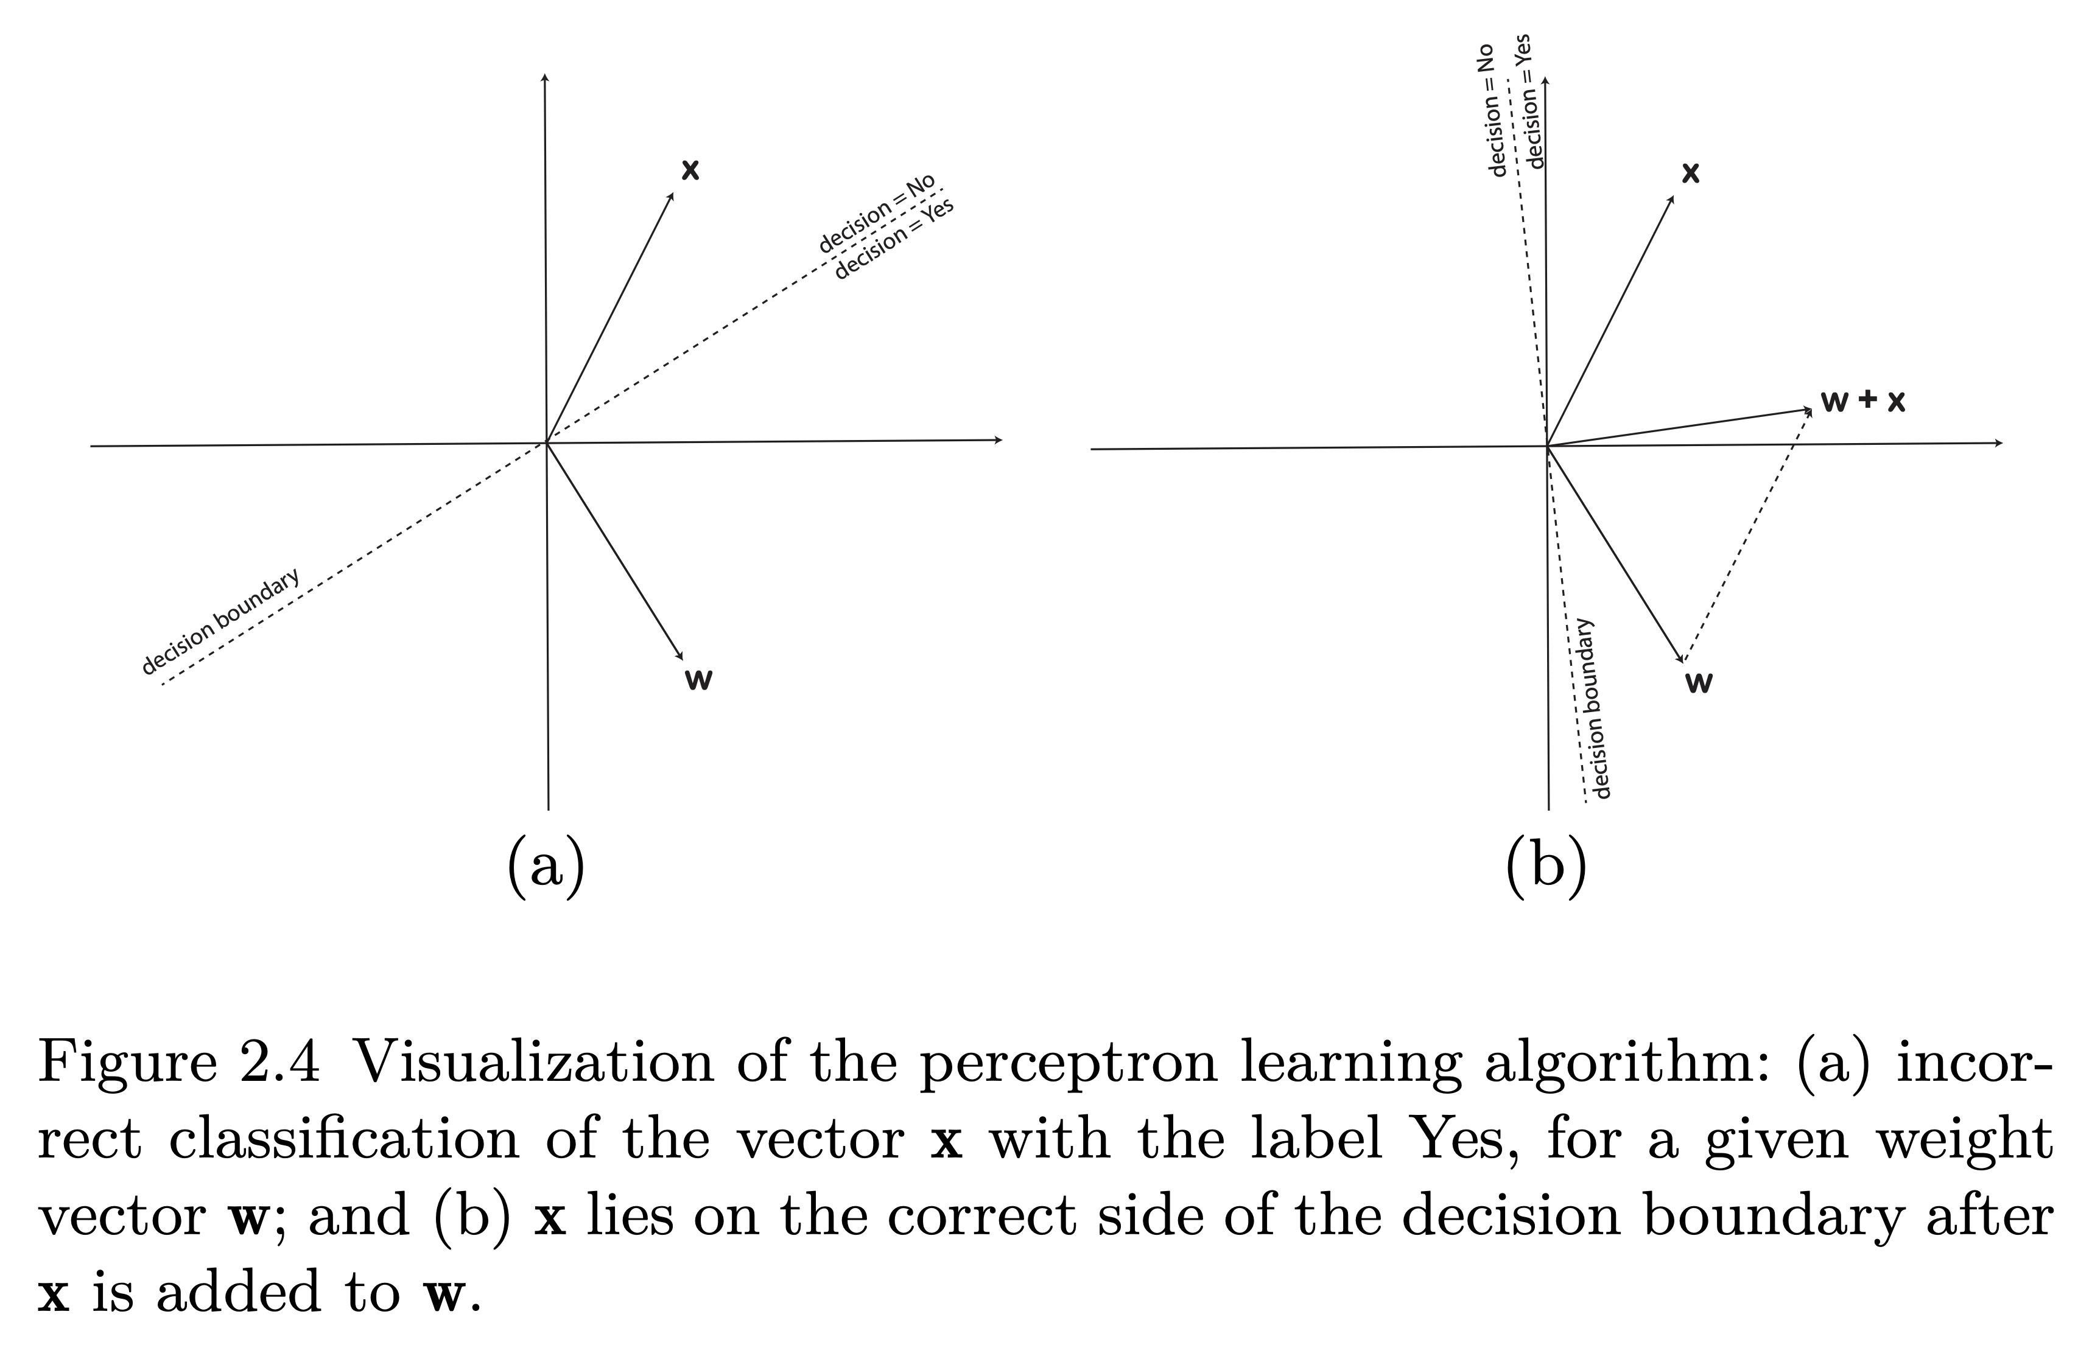
Visualizing the perceptron learning
In general, this line is a hyper plane. Classifiers whose decision boundary is a hyper plane are linear classifiers.

Slide 45
Voting perceptron
(how do we make the perceptron better?)

Slide 46
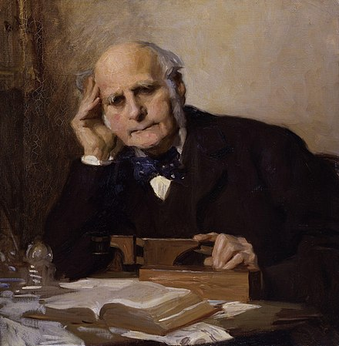
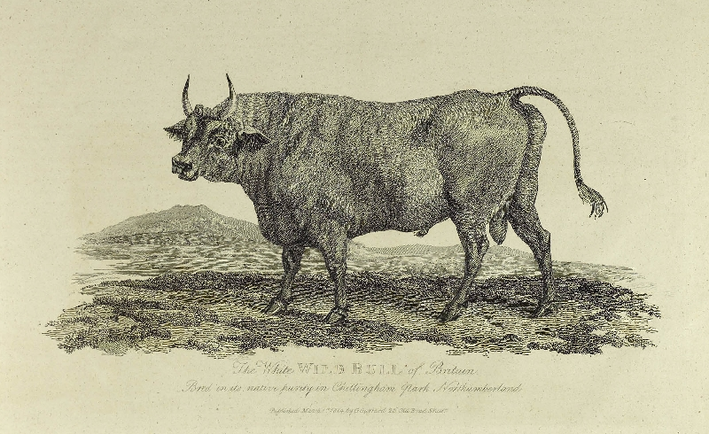
Wisdom of the crowds
Sir Francis Galton
Guessing the animal’s weight:
No individual guess was correct;
The average came within a pound or two of the correct weight!

Slide 47
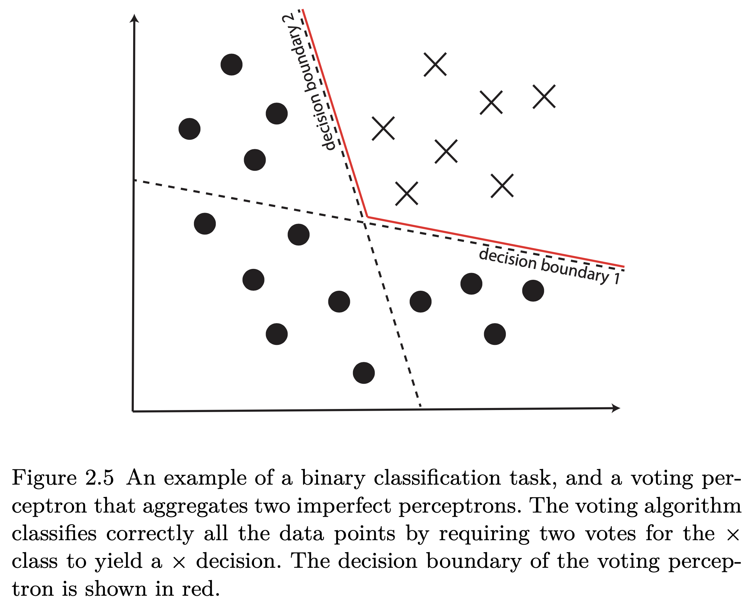
Voting perceptron example
Example from Erwin Chan’s Ling 539 course

Slide 48
What do you observe?
The voting perceptron performs better than any of the individual models
The voting perceptron is a non-linear classifier, i.e., its decision boundary is no longer a line (or a hyper plane in n dimensions)
Non-linear classifiers are crucial to learn from complex data!

Slide 49
How would you build a voting perceptron?
The key issue is how to train multiple perceptron models from the same training data (so we can vote between them)
Randomization:
Instead of initializing w and b with 0s, initialize them randomly. Repeat the training process multiple times to train different individual models. Or,
Sample with replacement from the training data to create multiple variants of the training corpus.
Both of these ideas require repeating the training process multiple times (once per model)!

Slide 50
How would you build a voting perceptron?
A simpler idea:
Keep track of all ws and bs that are produced during the training of a single perceptron. That is, before changing the b and w parameters in Algorithm 2 (lines 9 and 12), we store the current values (before the change) in a list.
We will have as many individual models at the end as the number of updates during training
We could sort them in descending order of their perceived quality:
The more iterations a specific b and w combination “survived” in training, the better the quality of this classifier is likely to be.

Slide 51
Main drawback of the voting perceptron
The voting perceptron is expensive to run
We need to run each individual model and then aggregate all their ”votes.”
The average perceptron addresses this issue because it uses a single model

Slide 52
Average perceptron

Slide 53
Key idea
Keep track of all w and b parameters observed during training
At the end of training, average them into a single model: avgW and avgB.
Single model → same runtime as the vanilla perceptron!

Slide 54
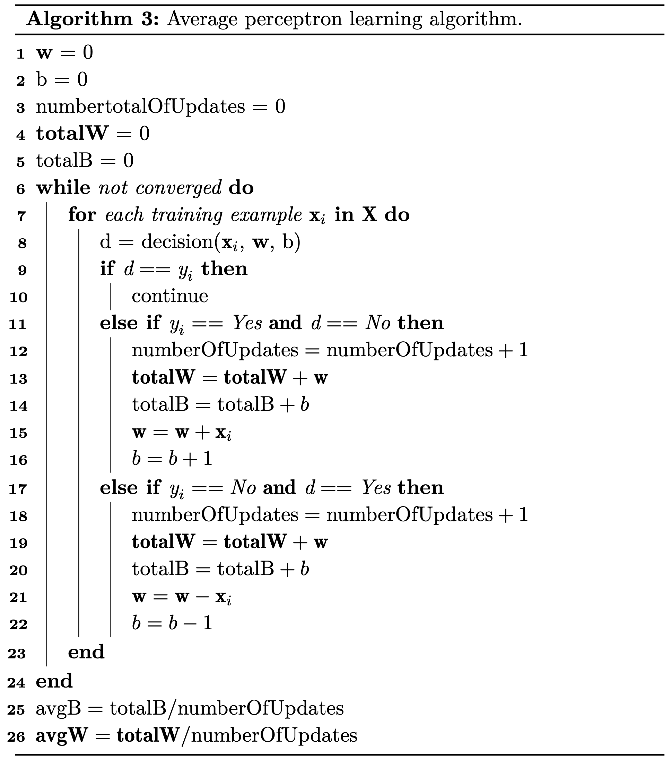
Algorithm

Slide 55
Why does the average perceptron work?
The average perceptron works better than a vanilla perceptron despite the fact that it is also a linear classifier!
The average perceptron controls better for noise
Noise = “unwanted variability in decision making” (Kahneman et al., 2021)
For example, the feature “harrowing” may be assigned a weight of +1 because it appeared in just one training example that happened to be positive.

Slide 56
Why does the average perceptron work?
These unreliable features are all over the place during training (sometimes +, sometimes –)
Averaging parameters squishes them (close) to 0, so they are effectively ignored
This process is called regularization. We will see other techniques later!

Slide 57
Evaluation measures for text classification

Slide 58
Evaluation
You trained your first review classifier
How well does it work?

Slide 59
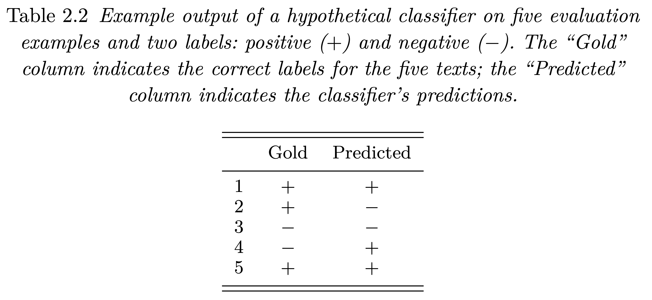
Example output
Also known as ”ground truth” labels. Why?

Slide 60
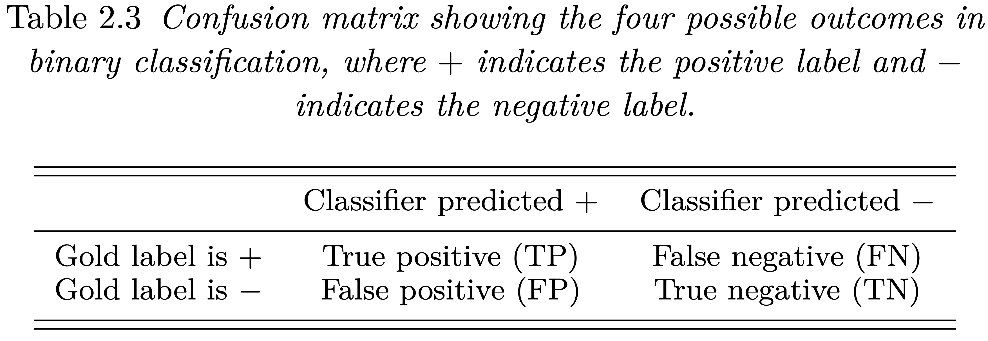
Confusion matrix

Slide 61
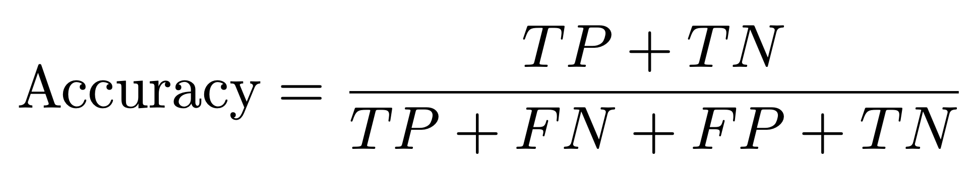
Accuracy
What is the accuracy of the previous example output?

Slide 62
When is accuracy misleading?
Accuracy is not informative in unbalanced scenarios, where the two labels are heavily unbalanced, i.e., one is much more frequent than the other, and we care more about the less frequent label.
Example: classifying infrequent but high-urgency Medicaid applications
For example, out of 1,000 applications only 1 is extremely urgent
What is the accuracy of a classifier that labels everything as not urgent?
Solution: focus just on the label of interest

Slide 63
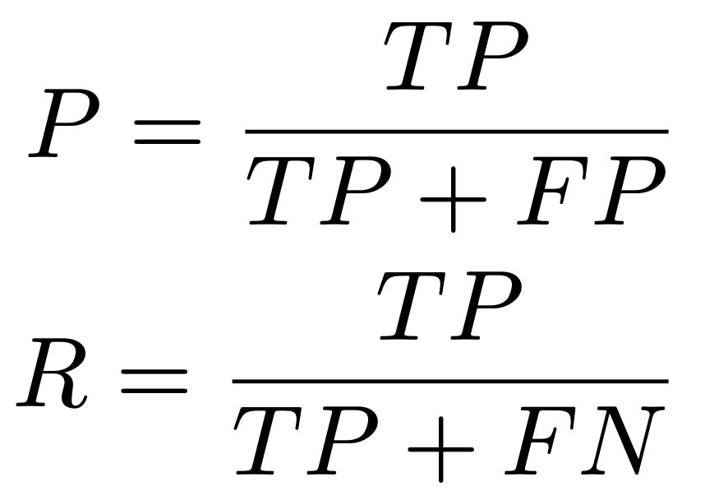
Precision, recall, F1
Precision (P) = proportion of correct positive examples out of all positives predicted by the classifier.
Recall (R) = proportion of correct positive examples out of all positive examples in the evaluation dataset.

Slide 64
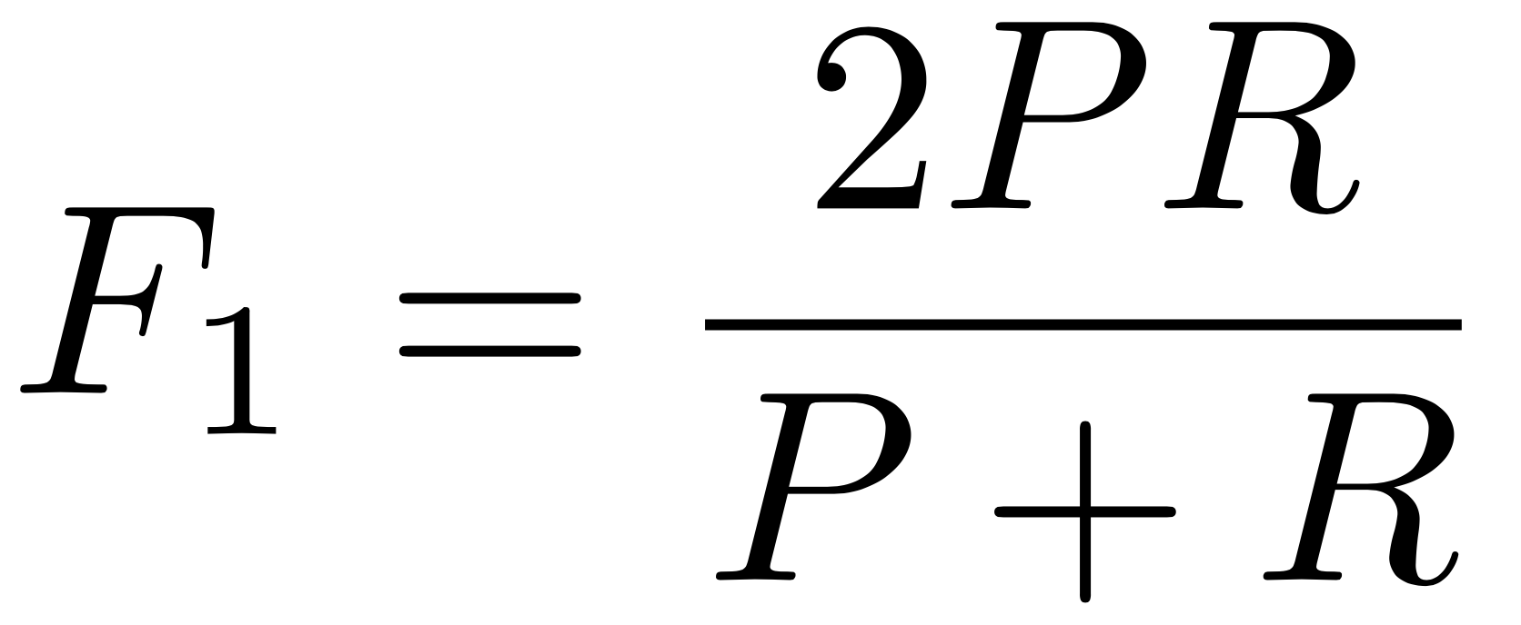
Precision, recall, F1
F1 = harmonic mean of precision and recall
What are the precision, recall, and F1 of the previous example output?

Slide 65
Why harmonic and not arithmetic mean?
The arithmetic mean is easy to game
For example, imagine a Medicaid classifier that labels every application as urgent. What is its P, R, arithmetic mean of P and R, and F1?
In general, the harmonic mean penalizes situations where the precision and recall values are far apart from each other.

Slide 66
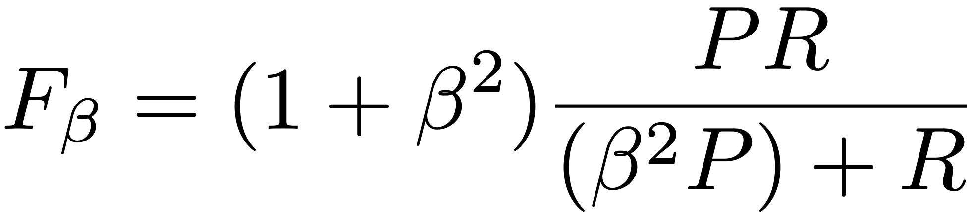
The general form of the F score
β indicates that recall is β times more important than precision.
If we prefer our Medicaid classifier not to miss urgent applications, do we want a β larger or smaller than 1?

Slide 67
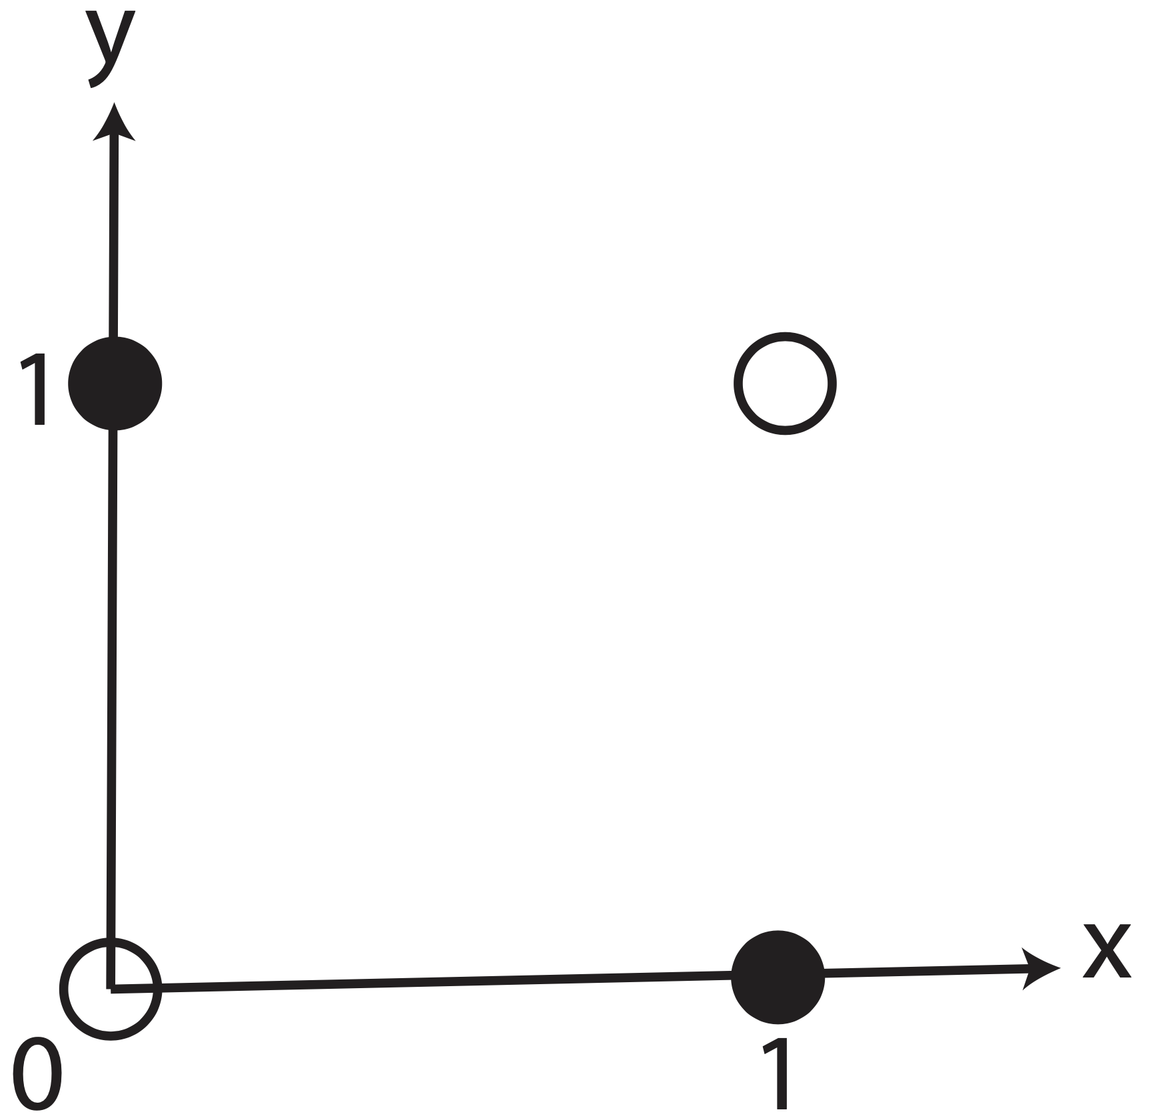
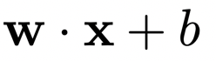
Drawbacks of the perceptron
It can only learn linear functions (unless we use the voting perceptron).
We hardcoded:
Addressed in chapter 5
It has no “smooth” updates during training.
This leads to instability during training and poorer performance during evaluation.
Focus of next chapter!
It relies on hand-crafted features (so far)
Discussed in chapter 8
It cannot produce structured output
Chapter 10 and beyond
What function is this?
Can this be learned by the perceptron?

Slide 68
Perhaps the first instance of AI hype
Rosenblatt stated: “Stories about the creation of machines having human qualities have long been a fascinating province in the realm of science fiction ... Yet we are about to witness the birth of such a machine – a machine capable of perceiving, recognizing and identifying its surroundings without any human training or control.”

Slide 69
Take away
Text classification
The perceptron decision function
The perceptron learning algorithm
Visualizing the perceptron learning
Voting perceptron
Average perceptron
Evaluation measures for text classification
Drawbacks of the perceptron

